Slide 1
PhD survey 2024

Slide 2
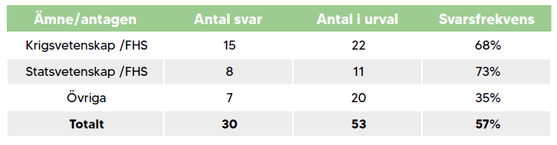
Selection
Subject/admitted Number of responses Number in selection Response rate
Comparison with 2021/22: 26 responses out of 42 respondents = 62% response rate

Slide 3
Qualifying education
30% studied fully or mostly at FHS (35%).
70% studied fully or mostly at another university (66%).
In brackets = results from 2022

Slide 4
Gender
13 Women 43% (6 Women 23%)
14 Men 47% (20 Men 77%)
Prefer not to answer 10% (not asked)
In brackets = results from 2022

Slide 5
Differences in responses between women and men
Fewer differences compared to 2022.
Men are more likely to state:
that they work more than 45 hours per week.
Women are more likely to state that they:
Experiencing greater concern about unemployment.
I more often feel that the acceptance of parental leave is lower.
A total of 70% (both women and men) state that they work more than 40 hours per week.

Slide 6
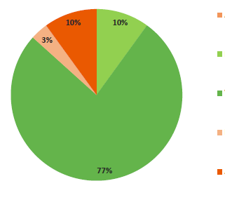
How do you feel about the requirements of doctoral education?
Too low
Slightly too low
Neither too low nor too high
Too high
Far too high

Slide 7
Supervision
The doctoral students state about the supervisors that they to a high or very high extent:
93% have shown interest in the doctoral studies (96%).
83% have given constructive criticism of the research work (92%).
63% have discussed method (76%), 47% theory (69%) and 50% choice of literature (65%).
In brackets = results from 2022

Slide 8
Supervision (continued)
The doctoral students state about the supervisors that they to a high or very high extent:
50% have discussed future plans (50%).
7% Have been in a situation of dependence in relation to supervisors who have felt troublesome (4%).
16% Experienced shortcomings in supervision that have been an obstacle to research work (4%).
In brackets = results from 2022

Slide 9
Courses
The doctoral students state to a high or very high extent:
69% The quality of the courses is consistently good (77%).
41% The courses are relevant to the thesis work (65%).
34% The course offerings correspond to wishes and needs (50%).
The courses have dealt with research ethics 62% (58%) and philosophy of science 66% (65%).
In brackets = results from 2022

Slide 10
Research Environment
The doctoral students agree to a high or very high degree:
63% participated in higher seminars outside their courses.
38% Experienced that the seminar activities at FHS have been rewarding/stimulating.
40 % There are good conditions for exchange with researchers in areas that are relevant to my work.
43% The researchers' work and scientific contacts are easily accessible.

Slide 11
Environment (continued)
The doctoral students agree to a high or very high degree:
56% felt that the requirements for the doctoral student were clear (66%).
23% The rights and obligations of doctoral students are clear.
25 % Issues concerning doctoral students are handled in a legally secure manner.
40% Experienced pressure/stress that has resulted in negative experiences (54%).
In brackets = results from 2022

Slide 12
Environment (continued)
The doctoral students agree to a high or very high degree:
33 % Had a say in the subject and department.
48 % The overall student social environment is good.
90% Worked as independently as they wanted.

Slide 13
Discrimination
Issues of discrimination based on:
gender
gender identity
ethnicity, religion or other belief
sexual orientation
disability
Questions broken down by:
Other doctoral
students
Teachers or other teaching staff
Supervisors
Administrative staff

Slide 14
Discrimination by…
Other doctoral students: 3% indicate ethnicity, religion or other beliefs.
Teachers or other teaching staff: 7% indicate gender 3% gender identity 3% ethnicity, religion or other beliefs.
Supervisors: 3% gender, 3% disability.
Administrative staff: 3% answered ‘don't want to answer’ to all options.
All answered “no” to the question whether they had been sexually harassed.

Slide 15
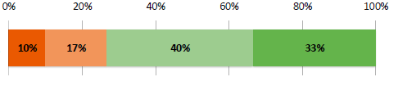

Importance of SEDU
To what extent is it important for your doctoral education and especially your dissertation work that you are active at the SEDU?
To a very low extent/not at all To a low extent To a high extent To a very high extent

Slide 16
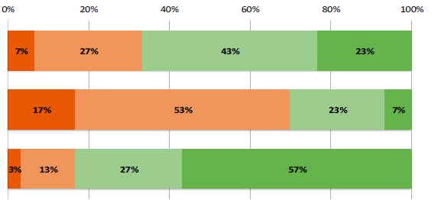
Future
Do you want to work at FHS after your PhD?
Do you want to work in the Swedish Armed Forces after your PhD?
If the choice were to be made now, would you choose to start a doctoral programme at SEDU?
Definitely not Probably not Probably Definitely

Slide 17
Finally…
… 35% of doctoral students grade very well on their doctoral education so far, 54% grade good.
65% agree to a high or very high degree that they have experienced the doctoral education as positive and stimulating.
Similar levels in 2022.

Slide 18
In conclusion...
On an overall level – positive and stimulating to be at SEDU.
The doctoral education environment can be developed and improved.
Greater clarity about requirements and expectations.

Slide 19
Some reflections...
Subjects continue to develop the research environment and work with the inclusion of the doctoral students.
The College of Supervisors is an important arena.
Further develop the research area.

Slide 20
Since the last survey
Programme Council for Doctoral Education.
Introduction of new doctoral students.
Dean's Doctoral Poster Session.
FUS has regular check-ins with the Union's doctoral student section.
Research lunches in Mässen.

Slide 21
Presentation of the survey
The Vice-Chancellor's management team (RLG)
Research and Education Board (FoUN)
The Research Council (Forskningsrådet)

Slide 22

The report will soon be available on MittFHS

